Slide 1
Elsevier Overview 2019
Helena Paczuska,
Strategic Account Manager CE, EE, Middle Asia
Helena Paczuska
15-18.04.2019

Slide 2
Education Frontlist 2019
Belarus 15-18.04.2019

Slide 3
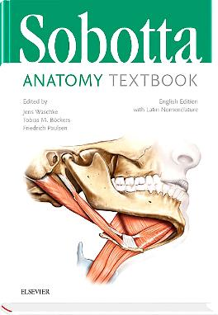
Sobotta Anatomy Textbook, 1st Edition
English Edition with Latin Nomenclature
Editors: Friedrich Paulsen & Tobias M. Böckers & Jens Waschke
Date of Publication: 11/2018
ISBN: 9780702067600
Price: Euro 74.77
Key features:
Clinical Cases
Clinical Remarks
Skills Boxes
Regular Note Boxes
This textbook guides students through the anatomy in a clear, structured manner that is easy to remember and enables you to develop a true understanding of the subject and thus not just pass
pass anatomy exams, but build a foundation for your future clinical work!

Slide 4
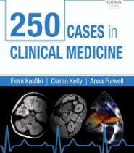
250 Cases in Clinical Medicine, 5e
By Kasfiki et al
Price: €35.99 IE price: €16.99
ISBN: 9780702074554
9780702074561 (I.E.)
Publication Date: 31/05/2019
Includes: Student Consult
New to this edition:
Cases alphabetised by system Procedures for the Core Medical Curriculum Symptoms-based cases Emergency presentations Self-assessment by system Accompanying e-book on StudentConsult Now in full colour

Slide 5
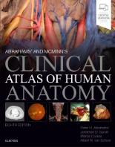
Abrahams’ and McMinn’s Clinical Atlas of Human Anatomy, 8e
By Peter H. Abrahams; Jonathan D. Spratt; Marios Loukas; Albert-Neels van Schoor
Price: €61.99 IE price: €31.99
ISBN: 9780702073328
9780702073335 (I.E.)
Publication Date: 31/01/2019
Includes: Student Consult, Evolve, Evolve Faculty Resources
New to this edition:
Labelled dissections integrated with modern imaging techniques on almost every page New and updated sections on neuroanatomy and the lymphatics (unique) New colour overlays added for harder to interpret dissections The accompanying enhanced eBook – including: 2000+ integrated clinical cases to help students understand the 500 most common clinical conditions Over 200 3D videos

Slide 6

Calculations and Pharmaceutics in Practice, 1e
By Jennie Watson & Louise Cogan
Price: €27.99
ISBN: 9780702074394
Publication Date: 30/05/2019
Includes: Student Consult
Key features:
Each chapter begins with Study Points and ends with Key Points to reinforce learning Appendices include medical abbreviations, Latin terms and abbreviations, systems of weights and measurements and presentation skills Some chapters also carry self-assessment questions for more complex areas

Slide 7
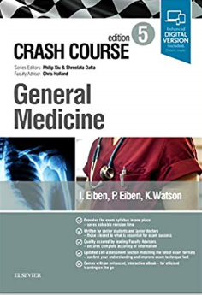


Crash Course 5th edition cycle
(note: a few aren’t 5es though!)
Price: €33.99 (except for Eiben: General Medicine 5/e €39.99 (much larger vol.)
Publication Date: December 2018 – January 2019
Includes: Student Consult
New to this edition:
New full-color page design throughout
New pedagogical features – including ‘Red Flags’ boxes
Extensive use of MCQs + new e-only clinical cases

Slide 8

The Developing Human, 11e
By Keith L. Moore; T. V. N. Persaud; Mark G. Torchia
Price: €61.99 IE price: €39.99
ISBN: 9780323611541
9780323611558 (I.E.)
Publication Date: 25/03/2019
Includes: Student Consult, Evolve, Evolve Faculty Resources
New to this edition:
New state-of-the art 3-D diagnostic images
Additional clinical cases, included for every chapter
the 18 innovative and stunning color animations, now with voice-over – very helpful for students to follow the complexity of organ and system formation.

Slide 9

Gordis Epidemiology, 6e
By Keith L. Moore; T. V. N. Persaud; Mark G. Torchia
Price: €38.99
ISBN: 9780323552295
Publication Date: 18/01/2019
Includes: Student Consult, Evolve (image bank, Q&A)
New to this edition:
New coverage includes expanded information on genetic epidemiology, epidemiology and public policy, and ethical and professional issues in epidemiology, providing a strong basis for understanding the role and importance of epidemiology in today’s data-driven society.
New glossary of epidemiologic terminology
New questions (at end of chapters, approx. 50% change); and new test bank for instructors that does NOT overlap with book or Student Consult questions

Slide 10

Gray’s Antomy for Students, 4e
By A. Wayne Vogl, Richard Drake, Adam Mitchell
Price: €62.99 IE price: €39.99
ISBN: 9780323393041
9780323611046 (I.E.)
Publication Date: 12/04/2019
Includes: Student Consult, Evolve, Evolve faculty resources
New to this edition:
The enhanced eBook including self-assessment; clinical cases; an updated ‘Interactive Surface Anatomy’ tool; online anatomy and embryology self-study course.
Bonus eBook chapters, covering:
  Each major body system
  Neuroanatomy (essentials)
  Simplified, introductory ‘schematic’ drawings for key structures/topics

Slide 11


The ECG Made Easy, 9e
By John Hampton, Joanna Hampton
ISBN: 9780702074578
9780702074660 (I.E.)
Price: €22.99 IE price: €14.99
Publication Date: 02/04/2019
Includes: Student Consult
New to this edition:
For over forty years The ECG Made Easy has been regarded as the best introductory guide to the ECG, with sales of over half a million copies as well as being translated into more than a dozen languages.
A brand new first chapter has been added for this edition: The ECG made very easy indeed!

Slide 12

Human Embryology & Developmental Biology, 6e
By Bruce Carlson
ISBN: 9780323523752
Price: €61.99
Publication Date: 14/01/2019
Includes: Student Consult, Evolve faculty resources (image bank)
New to this edition:
Animations on studentconsult.com ‘Clinical Correlation” Boxes / “Clinical Vignette” boxes / “Summary” boxes – for quick revision of the clinical manifestations of abnormal development Review questions with each chapter Original photos of congenital anomalies Clear coloured illustrations

Slide 13

Learning Radiology: Recognizing the Basics, 4e
By William Herring
ISBN: 9780323567299
Price: €44.99
Publication Date: 13/05/2019
Includes: Student Consult, Evolve Faculty Resources
New to this edition:
Student Consult includes videos/images of 3D images, functional imaging examinations, dynamic studies, and additional assessments More than 700 images and an easy-to-use format and pedagogy, including: bolding of key points and icons designating special content; Diagnostic Pitfalls; Really Important Points; Take-Home Points; and brand new Image-Guided Intervention

Slide 14

Netter’s Neurology, 3e
By Jayashri Sriniavasan, Claudia Chaves, Brian Scott, and Juan Small
ISBN: 9780323554763
Price: €84.99
Publication Date: 01/05/2019
Includes: Expert Consult
New to this edition:
Netter’s Neurology is the Choice Outstanding Academic Titles WINNER and First Prize WINNER, Illustrated Book Category, British Medical Association Medical Book Competition. New chapters include Laboratory Evaluation in Neurology; Neuroimaging in Neurologic Disorders; Neurologic Emergencies; Neurologic Monitoring in Critical Care. Over 180 clinical vignettes throughout 71 chapters. Expert Consult access includes links to 24 printable patient education brochures.

Slide 15
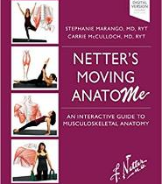

Netter’s Moving AnatoME, 1e
By Stephanie Marango, MD, RY and Carrie B. McCulloch
ISBN: 9780323567336
Price: €35.99
Publication Date: 05/04/2019
Includes: Student Consult
Key features:
VIDEOS on Student Consult – there are over 40 of them!
Foreword by Joy S. Reidenberg…some may recognize her name from TV (“Inside Nature’s Giants,” National Geographic, and others)

Slide 16
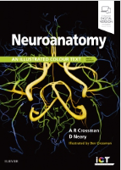
Neuroanatomy: an Illustrated Colour Text, 6e
By: Alan R. Crossman, David Neary
ISBN: 9780702074622
Price: €41.99
Publication Date: 23/02/2019
Includes: Student Consult, Evolve, Evolve Faculty Resources
New to this edition:
Full-color, easy-to-understand illustrations The addtional use of new state-of-the-art MRIs Additional material in the enhanced eBook – further modern imaging examples + newly prepared MCQs

Slide 17

Nolte's The Human Brain in Photographs and Diagrams, 5e
By: Todd Vanderah
ISBN: 9780323598163
Price: €49.99
Publication Date: 04/01/2019
Includes: Student Consult
New to this edition:
Chapter 10, Neuropathology Imaging Comprehensive review examination on Student Consult

Slide 18

Stevens and Lowe’s Human Histology, 5e
By James Ritter, Rod Flower, Graeme Henderson, Yoon Kong Loke, David MacEwan, Humphrey Rang
ISBN: 9780323612791
Price: €59.99
Publication Date: 05/03/2019
Includes: Student Consult, Evolve Faculty Resources (image bank)
New to this edition:
The Virtual Histolab Online review questions Online cases Online videos

Slide 19


Wheater’s Pathology , 6e
By Geraldine O’Dowd, Sarah Bell and Sylvia Wright
Price: €59.99 IE price: €27.99
ISBN: 9780702075599
9780702075605 (I.E.)
Publication Date: 29/04/2019
Includes: Student Consult, Evolve, Evolve faculty resources
New to this edition:
Atlas style layout Quality of images Keys to images – to assist with understanding Additional online only gross pathology and anatomical pathology Self-assessment MCQs

Slide 20




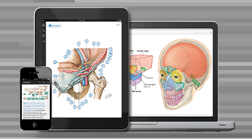

print PLUS online
Medical
Reference
Multimedia.
Social. Reading.
Medical
Textbook
Images. eBook. Slides.
Training. TestBank. …
Nursing
Physiotherapy
Notes:
Covers the major disciplines and established brands that we know sell well

Slide 21

Educators

Slide 22
StudentConsult
The StudentConsult platform combines Elsevier’s world-class book content and improved search, rich media, and social and community features from Inkling.
StudentConsult is a B2C platform and hosts books for undergraduate medical, biomedical and pharmacy courses.
Many (although not all) of the medical undergraduate titles come with access to the full eBook via the StudentConsult platform. In many cases there are additional multimedia features and additional content available such as: MCQ questions, cases, videos, animations etc.
This is accessed via a PIN code printed on the inside front cover of the books which can be redeemed onced on the platform.
https://studentconsult.inkling.com/

Slide 23
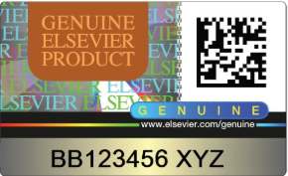
Unique Book IDs / Anti-Piracy Hologram
Selected Elsevier books are now protected with a unique holographic security seal
The unique IDs allow customers – trade and end user – to identify genuine Elsevier products
Piracy and counterfeiting prevent funds from being reinvested in research and resources, limiting progress in the field of medicine. Elsevier is committed to improving education, facilitating scientific discoveries and supporting the content and information industry.
www.elsevier.com/genuine

Slide 24
Contact details
Elsevier
Helena Paczuska
Strategic Account Manager
Central and Eastern Europe, Russia and Middle Asia
e-mail: H.Paczuska@elsevier.com
www.elsevier.com
Delsar – exclusive distributor in Belarus
Igor Radyuk
Managing Director
e-mail: rdk@lit.by
www.delsar.by

